Slide 1

Port Planning & Investment Toolkit
Planning Module
Pacific Northwest Ports Webinar
August 11, 2020
Wade Morefield
Office of Ports & Waterways Planning
Notes:
Good morning or afternoon!
I want to thank Bruce Lambert, our PNW Gateway Director for arranging this event today and I’d also like to thank everyone in attendance for taking time to participate.
It’s my pleasure to be here today and have a chance to speak to you about the Planning Module of the MARAD Port Planning and Investment Toolkit.
We often talk w/ our port community about the toolkit, but we don’t typically get down into any real level of detail about WHAT is actually IN the toolkit. Especially the planning element. So I hope that the information presented today will make you think a little bit about your individual planning efforts and get you to take a closer look at the toolkit. It’s a great resource.

Slide 2
Office of Ports & Waterways
MISSION
Improve the Maritime Transportation System, including Ports, Connectors and Marine Highways through Investment, Integration and Innovation to meet the current and future needs of the Nation.
VISION
A capable, connected system – water, road and rail – to benefit every American.
GOAL
Increase national cargo capacity and improve the reliability of freight movements through ports.
Legislative Authority - Port development - 46 USC 50302
2
Notes:
First, a quick note about our MARAD Office of Ports & Waterways mission.
The primary goal of our office is to increase national cargo capacity and improve the reliability of freight moving through ports.
Towards that end, we are always available to provide technical assistance to ports and port stakeholders. If you have questions or need assistance with your project efforts, please reach out to us (either through Bruce, your Gateway Director, or directly).
We serve as a clearinghouse for information and resources that may be useful in your project planning. We also learn and grow through your questions.
We won’t tell you WHAT to do, but we can certainly help you with the HOW. Particularly as it relates to Federal assistance programs.
The bottom line is that we want ports to be successful.

Slide 3
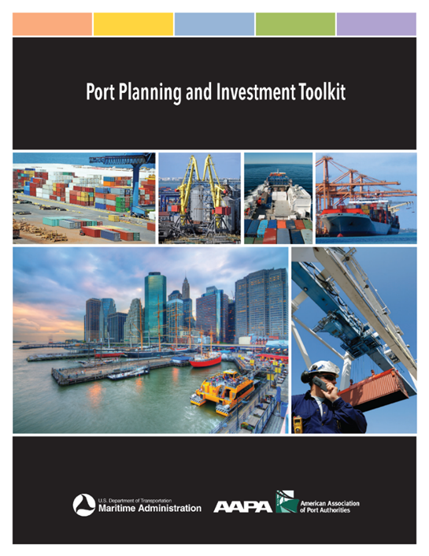
Port Planning & Investment Toolkit – Background
Port Planning & Investment Toolkit (PPIT)
A Maritime Industry Joint Initiative
A joint effort between MARAD and AAPA
The Toolkit modules can be used to help ports:
  Evaluate port conditions;
  Define problems;
  Plan thoroughly;
  Navigate the preplanning process;
  Engage private partners;
  Present actionable needs;
  Access available funding; and
  Complete projects
The toolkit helps ports obtain funding
http://www.aapa-ports.org/PPIT
Notes:
So how does MARAD help ports be successful?
Technical assistance is one way. MARAD has developed technical assistance tools that are based on expertise obtained through outreach efforts with the maritime industry and stakeholders like you.
The Port Planning and Investment Toolkit is our primary technical resource. We understand all ports are not alike, and the tools and techniques described in the toolkit can be used at varying levels of intensity by all types of ports.
The toolkit is a joint initiative w/ the port and maritime sectors with considerable assistance from the American Association of Port Authorities. MARAD will continue to work with industry partners to develop new modules and update existing modules. (ITS module, Marine Highway Module).
-READ SLIDE BULLETS and “help ports obtain funding” whether it be public or private. The toolkit is hosted on AAPA’s website and we hope to get it back on our MARAD website soon.
I’d also want to be clear that the AAPA did a lot of the heavy lifting to create the toolkit and we appreciate their work and continued assistance. AAPA engaged a lot of ports (27, I think) and port professionals (including PPM candidates) to help MARAD develop this toolkit. In the PNW, I believe the ports of Portland and Coos Bay provided input. We’re grateful for their assistance in sharing important information about their specific port development strategies and activities.

Slide 4
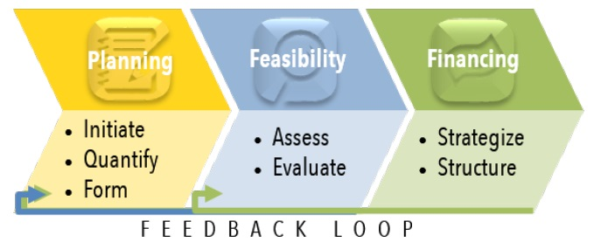
Port Planning & Investment Toolkit – Format
Notes:
The core modules are Planning – Feasibility – and Financing. Kirk Claussen from our office spoke w/ you on July 28 about the Financing module.
I pulled this graphic from the Introduction and User’s Guide segment of the toolkit because it clearly shows how the 3 primary modules of the toolkit are structured and how they all relate to each other. As you digest the techniques described in the toolkit, you’ll find there is a continuing theme of feedback between each of the project development stages.
I think the AAPA did a great job reflecting what they learned from ports about how any planning process needs to be iterative and capable of adjusting to changes in the context of a project.
Today I’m going to review the Planning Module, but perhaps we can review the Feasibility Module at a later date.

Slide 5
Planning Module
A “build it and they will come” strategy has little likelihood of success.
A project based on insufficient planning generally ends with unsustainable results.
Projects based on a thorough evaluation of data, stakeholder involvement, and alternatives will be much more likely to generate long term economic benefits (REVENUE).
Notes:
Before we move on, I just want to acknowledge (as does the toolkit) that a “build it and they will come strategy has little likelihood of success.”
This is a statement that bears repeating and it sets a baseline for this presentation.
5:00 at end of this slide.
In all honesty, I’ve participated in “build it and they will come” projects and the results were…lackluster. These types of “ad-hoc” projects are usually based more on opportunities for FUNDING (a “good deal” on equipment or a “great offer” from a development partner) rather than a methodical and sound STRATEGICALLY DRIVEN DECISION MAKING PROCESS.
PRO TIP - We see this all the time in Federal grant applications. A grant NOFO includes specific evaluation criteria, so an applicant submits an application that acknowledges, but fails to SUBSTANTIVELY address those criteria. I’ll tell you right now that “build it and they will come” applications for Federal Assistance stand little chance of receiving a grant award. The level of competition is just too high.
BUT…the practices outlined in the toolkit’s Planning Module can help you make strategically driven decisions that will help you prepare better grant applications AND better support other types of investment decisions.

Slide 6
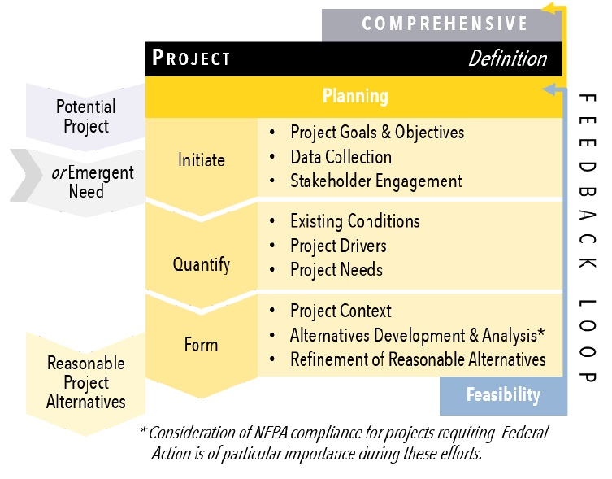
Planning Module – Introduction
Notes:
This chart from the toolkit describes the primary planning phases described in detail in the Planning Module. They include:
Initiate – the planning process;
Quantify – the conditions, drivers, and needs; and
Form – the project context and alternatives.
This general approach can be refined and customized, as appropriate, by individual ports to reflect local conditions, opportunities, and project specific requirements. The goal of the process remains the same - identify solutions that are practical and viable.
PRO TIP – Again, you’ll see the “feedback loop” with the Feasibility phase noted on the right side of the graphic. Conditions change, and your planning needs to be structured in such a way to accommodate changes in assumptions that may arise during the project’s development.
As I said, the processes described throughout the toolkit do a very good job of relating all of these elements to each other.

Slide 7
1. Initiate – Kickoff
The first step of project initiation is a series of kickoff meetings with key project members and stakeholders. The kickoff meetings should address the following items, at a minimum:
Project team and stakeholder points of contact;
Roles and responsibilities;
Project quality control and communication protocols;
Sources of information;
Work program, milestones, and schedule;
Key project issues and sensitivities, including outreach and other permitting requirements; and
Guiding elements.
Notes:
The Project Initiation phase involves developing a thorough understanding of the objectives guiding the effort, as well as stakeholder perspectives that may affect the specifics of a potential project’s direction. So the first step discussed in the Planning Module is kickoff meetings and the toolkit gives a good overview of what, at a minimum, your objectives should be at this stage of the initiation phase.
-READ SLIDE-
PRO TIP - Note that this effort does not typically include EXTERNAL stakeholders, unless there is a particular need or perspective that they can address.

Slide 8
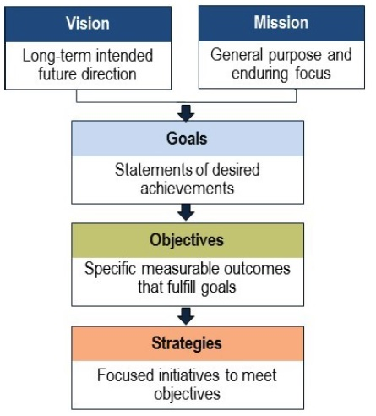
1. Initiate – Guiding Elements
Guiding Elements Provide a Basis for:
Developing new project elements;
Prioritizing competing elements; and
Comparing alternatives as the project planning progresses.
Notes:
8:00 to the end of this slide
The kickoff stage should, ultimately, generate a set of “guiding elements” that will be used throughout the planning process. Here’s a graphic from the toolkit that describes these principles.
-READ SLIDE EXAMPLES OF GUIDING ELEMENTS-
Basically, these elements or statements, should reflect a thorough consideration of how a particular project relates to existing port policies, priorities, and relationships. The guiding elements should capture those important and unique aspects of your port as they might relate to a proposed project.
The policy and guiding elements provide a basis for:
Developing new project elements:
Prioritizing competing elements: and
Comparing and contrasting alternatives as the project proceeds.
PRO TIP - The project goals and objectives will also be critical when it comes time to create evaluation criteria in the Feasibility phase of project development. And they should be revisited periodically to ensure the project plan continues to align with stated objectives and other port priorities. Or to capture changes in those overall priorities..

Slide 9
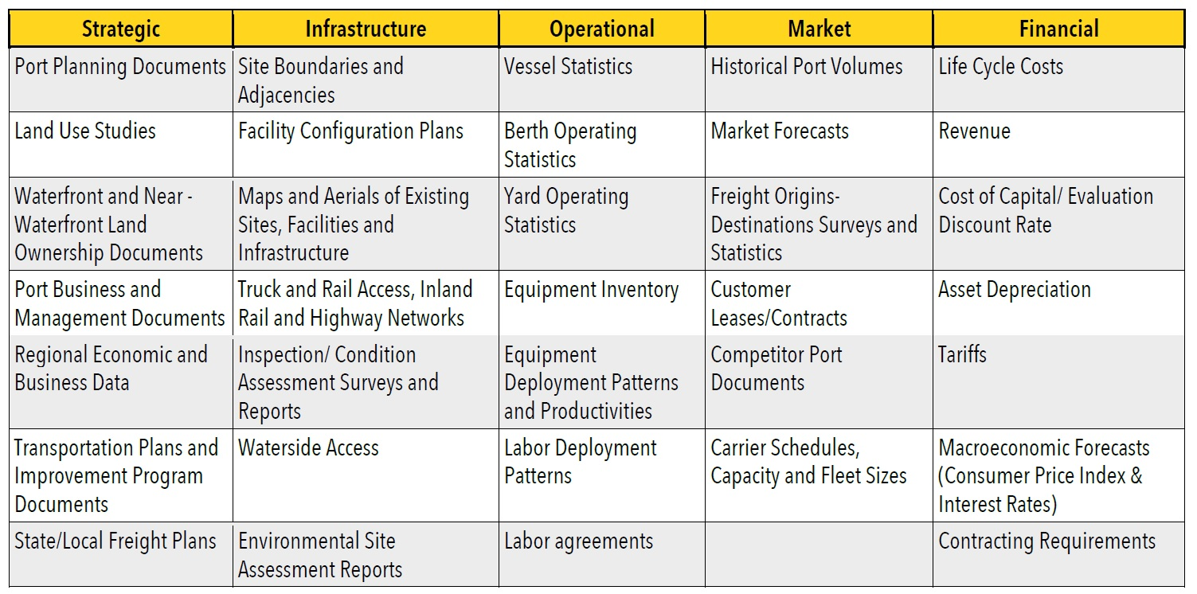
1. Initiate – Data Collection
Data collection begins during kickoff, but continues throughout the project development process.
The project team should develop an understanding of:
What data is available;
The applicability of data to the project; and
The expected uses of the collected data.
Notes:
After the organization has established the guiding principles, the next step is to compile the data that will inform your planning.
This table from the toolkit illustrates just some of the many types of data that might be important during the project planning process.
It’s important to note that data collection is never a “one and done” effort. Although it should begin during the kickoff meetings (or before), data collection should continue throughout the project definition process (and beyond, probably).
In order to make the best use of data, the project team should have a clear understanding of:
What information is available;
The applicability of available data related to the project; and
The expected uses of the collected data.
Some data may be readily available, while other data may need to be collected.
PRO TIP - This is where I put in a plug for SURVEY DATA. SURVEYS are very useful tools for collecting specific data to support a particular project. Targeted surveys of relevant shippers, carriers, logistics providers, terminal operators, truck drivers, etc. can improve understanding of the port’s current market within the port region, as well as any priorities, requirements, and concerns. But it’s important to recognize that the results of survey data should be SUPPORTED (or VERIFIED) by other data sources wherever possible. Surveys also are a good way to engage relevant stakeholders and, in the case of a Federal grant project, solicit indications of support for a project.

Slide 10
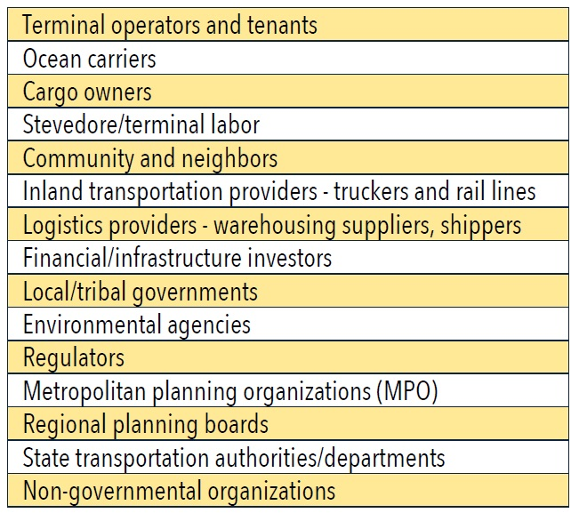
1. Initiate – Stakeholder Engagement
Stakeholder Outreach
Informs the overall vision;
Aids in ensuring plans best serve ALL objectives; and
Identifies potential roadblocks early on.
Notes:
With clear guiding elements defined during the kickoff meetings and an understanding of the data that will be needed to inform project planning decisions, the next step in the project initiation phase is formal stakeholder engagement.
PRO TIP – note that although the toolkit lists these activities in a sequence, ideally there will some overlap between the activities to better inform each effort.
This chart from the toolkit describes the different types of stakeholders that should be considered for outreach to inform your project planning efforts. Identifying the project stakeholders and understanding their concerns is critical to a successful project.
Stakeholder outreach:
Informs the overall project vision;
Aids in ensuring that plans address ALL objectives (even those you may not have considered previously); and
Identifies potentially catastrophic and/or expensive roadblocks early on (environmental particularly).
Stakeholders should be engaged both early AND often throughout the planning process. The toolkit provides additional helpful information for stakeholder involvement.

Slide 11
1. Initiate – Stakeholder Engagement, cont.
PROJECT ADVISORY PANEL
A Project Advisory Panel is recommended to:
Help form/refine project goals and objectives;
Identify internal and external stakeholders;
Provide insights on external forces that may impact the project;
Facilitate stakeholder connections and communication;
Secure community support for the project;
Review and evaluate findings from interviews and data analyses; and
Provide validation and quality assurance on the draft and final project planning documents.
Notes:
One recommendation in the toolkit is the creation of a Project Advisory Panel to lead the overall outreach effort.
The Advisory Panel should:
Involve key “players” in the project development process; and
Other individuals who can enhance the project plan through their expertise and knowledge, such as facility owners and operators, community leaders and/or freight industry representatives.
-READ SLIDE-

Slide 12
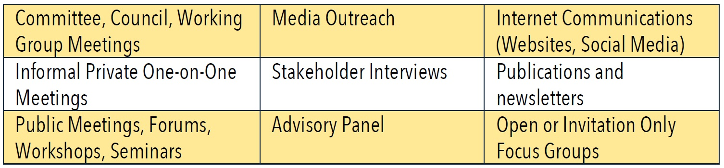
1. Initiate – Stakeholder Engagement, cont.
Notes:
Here’s a chart from the toolkit that describes some of the many types of stakeholder engagement that should be considered to best solicit feedback, gain project support, and identify potential roadblocks early on.
As you can see, a lot of the “heavy lifting” is recommended to be led by the Project Advisory Panel.

Slide 13
1. Initiate – Stakeholder Engagement, cont.
WORKING WITH YOUR MPO
Port owners should partner with their MPOs to ensure that their plans are complementary, and ports should involve their MPOs when planning projects that will impact the local transportation network.
Certain port projects should also be incorporated into local, regional and state planning documents such as a city’s capital improvement program (CIP), an MPO Transportation Improvement Program (TIP), Statewide Transportation Improvement Program (STIP), a Long Range Transportation Plan (LRTP), or other similar planning and funding documents.
Incorporation of projects into these plans can be a first step in securing funding through the Federal-aid formula programs such as the National Highway Freight Program.
Notes:
Finally a plug to please work with your MPOs , not only for stakeholder engagement, but for overall alignment of port capital planning with MPO transportation planning. Under current Federal transportation legislation, ports are eligible for a percentage of National Highway Freight Program funds, but that requires coordination with State transportation funding plans. And the MPO is typically the first step for that coordination.
The toolkit includes a sidebar about the importance of involving MPOs in the project planning process.
Ultimately, it is ideal if appropriate port projects are included in local, regional, and state transportation planning documents. These documents include County Capital Improvement Plans (CIPs), Long Range Transportation Plans (LRTPs), MPO Transportation Improvement Programs (TIPs), Statewide Transportation Improvement Programs (STIPs), and other capital plans and funding documents.
Ports may also be represented on an MPO Technical or Citizens Advisory Committee. These committees provide opportunities to discuss port planning projects and solicit feedback from other MPO entities on the suitability of inclusion in the MPO work program.

Slide 14
2. Quantify
QUANTIFY CAPABILITIES, DEMANDS, AND NEEDS
  Existing Conditions
    Assets
    Operations
    External Influences
    Volumes and Trade Flows
    Capacity
  Project Drivers
    Regulatory/Environmental
    Market Dynamics
    Competitive Position
    Demand Forecast
  Project Needs
    Gap Analysis
Notes:
13:00 MINUTES
After the Project Initiation phase, the toolkit describes the next planning phase, the Project Quantification phase.
The Project Quantification phase will formally assess the port’s capabilities, demands, and needs that relate to the proposed project.
Factors that are discussed in the toolkit are listed here. Specifically, they are: -READ SLIDE-

Slide 15
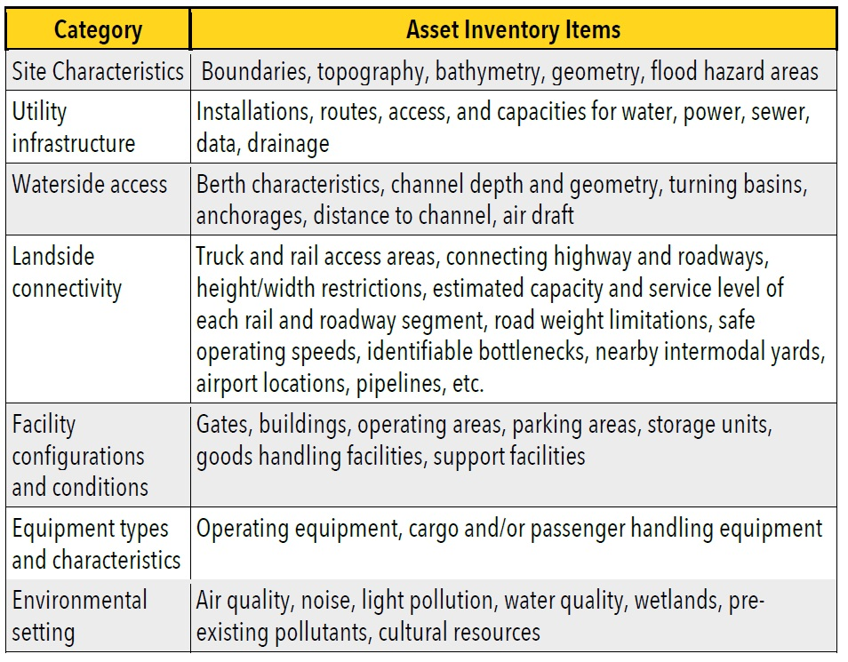
2. Quantify – Existing Conditions, Assets
An inventory of assets is fundamental to understanding your strengths.
More importantly, it may identify weaknesses that may need to be addressed.
Notes:
Here’s a toolkit example of an asset inventory that might be used to assess existing conditions.
The asset inventory should include an assessment of the condition of all relevant port infrastructure (and off-port supporting infrastructure) with respect to the proposed project.
An inventory of assets is FUNDAMENTAL to understanding your strengths, but more importantly your WEAKNESSES that need to be addressed.
PRO TIP – Resiliency
The effort may also involve investigating the port’s historical performance, and researching the land use, regulatory, labor, environmental, and cultural setting at the port. Port flood hazard areas should be given consideration to ensure the project plans take into account resilience to extreme weather and sea level rise. The assessment should also determine how nearby road and rail infrastructure may impact the potential project.

Slide 16
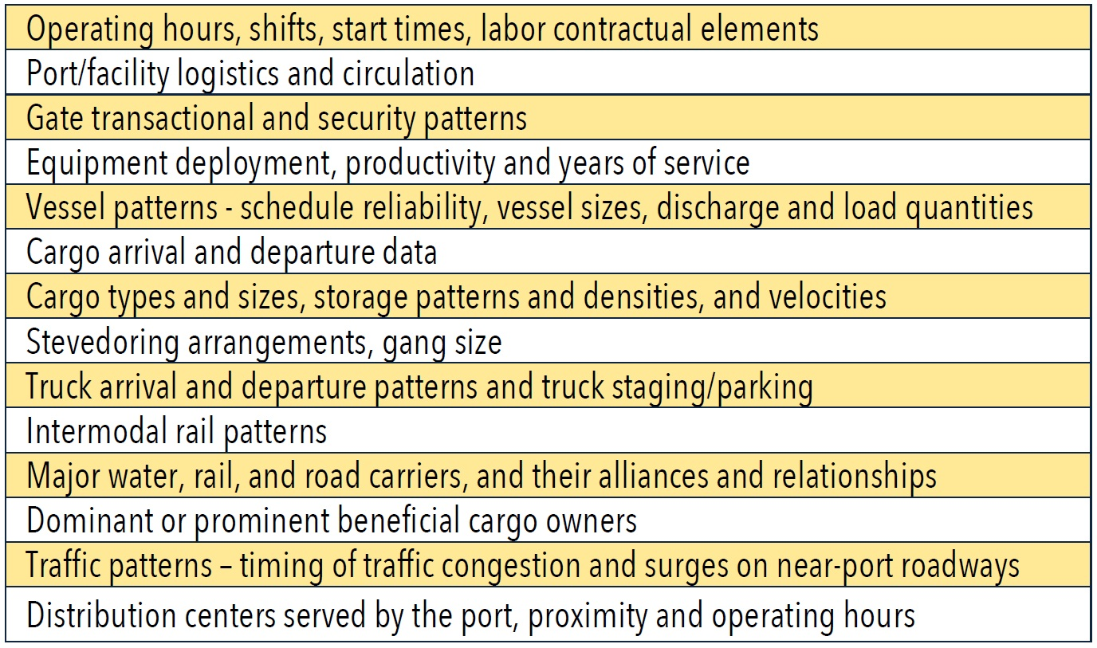
2. Quantify – Existing Conditions, Operations
Notes:
Another quantification effort is your (or your terminal operator’s) operational capabilities.
The toolkit recommends development of an Operational Profile for both current facilities and potential project locations based on
Site visits,
Interviews with operators; and
Data collected on operating patterns.
This chart from the toolkit lists some operational components that can be considered for port project planning.

Slide 17
2. Quantify – Existing Conditions, External Influences
EXTERNAL INFLUENCES
External influences include but are certainly not limited to programs, policies, programs, priorities, laws, and regulations relating to:
Land Use and Zoning Restrictions;
Political Realities;
Environmental Impacts (good or bad); and
Regulatory Requirements.
It’s important to communicate how a proposed project might assist in achieving wider regional goals.
Notes:
The next item to be quantified is external influences that may result in either negative or positive (or both) outcomes for the overall project planning effort.
If it is a negative outcome, then it is best that it was caught at this stage of planning.
If it is a positive outcome, then that can be used to build a partnership or additional momentum towards a preferred project alternative.
In dealing with external influences, ports should work with relevant organizations and stakeholders to communicate how the project goals can assist in achieving wider regional goals, such as attracting new businesses, increasing middle-class jobs, and promoting economic development.

Slide 18
2. Quantify – Existing Conditions, Volumes and Trade
VOLUMES AND TRADE FLOWS
The project plan should reflect a thorough understanding of the port’s role in its wider marketplace.
The research and analysis should combine statistically valid and verified data collected during the Data Collection step to fully inform the planning process on port volumes, origins and destinations, commodity types, and transportation modes.
Notes:
While volumes and trade flows should need to be quantified, the important thing is that these factors should be well understood and any assumptions regarding future trade flows and volumes should be well documented and any supporting data should be clearly described.
As I mentioned a moment ago under data collection, a targeted survey of relevant shippers, carriers, logistics providers, and terminal operators can improve understanding of the port’s current market within the port region, as well as any priorities, requirements and concerns.
This information will serve as a baseline from which market-driven forecast scenarios can be developed both during the alternatives assessment and feasibility phases of the project development effort.

Slide 19
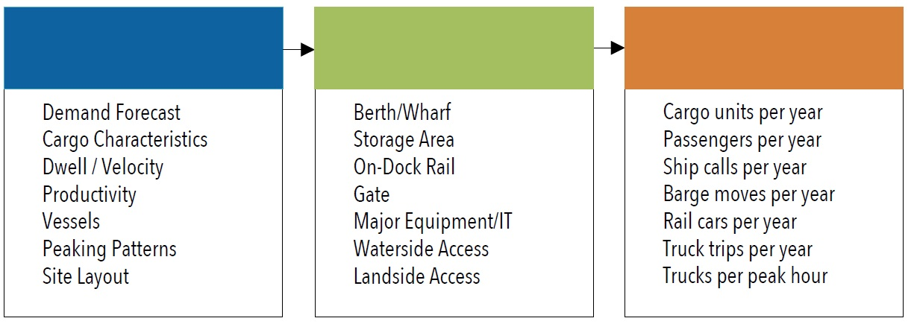
2. Quantify – Existing Conditions, Capacity
Notes:
The final consideration for quantifying existing conditions described in the toolkit is an assessment of capacity. Capacity is a primary variable used to justify project needs and to ultimately quantify project improvements/costs.
Because of the importance of capacity to overall project success, a sound and defensible approach to estimate capacity is required.
This chart from the toolkit illustrates a straightforward framework for performing a throughput capacity analysis.
There are numerous methods to estimate capacity and specialized technical assistance may be required. In order to assist ports with an initial assessment of their capacity the Port Planning and Investment Toolkit includes additional details on models and tools that can be used and it even includes an example approach to perform a basic static capacity analysis.

Slide 20
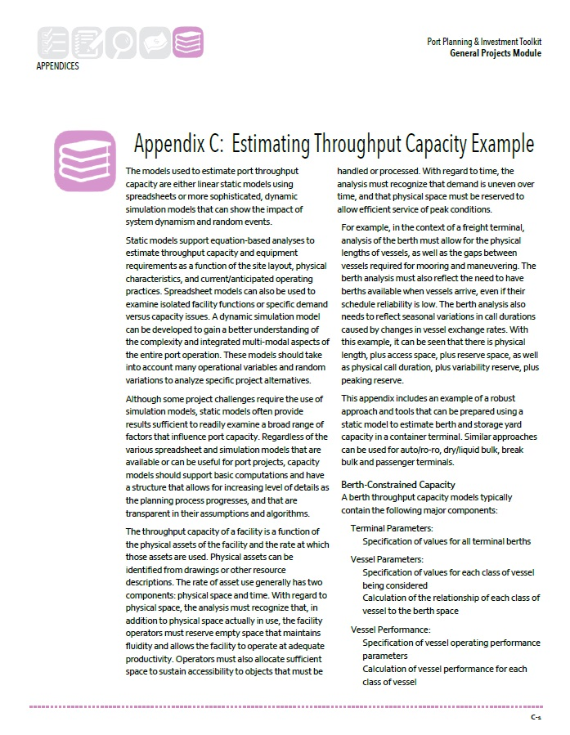
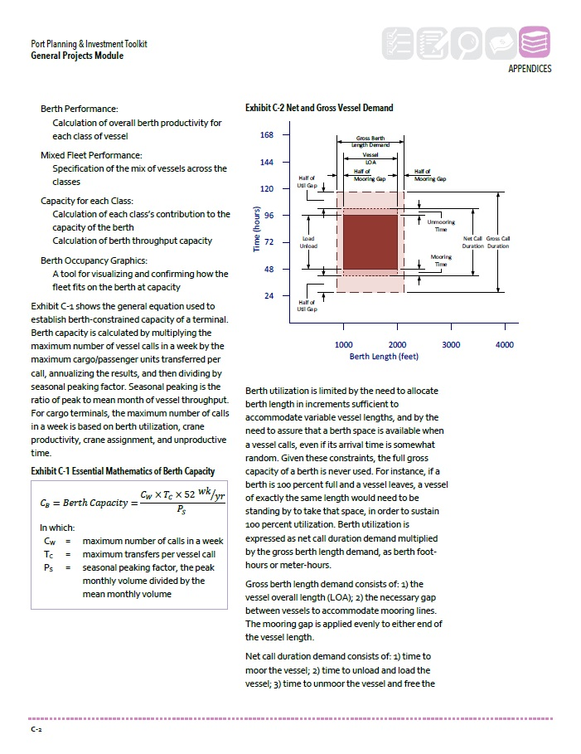
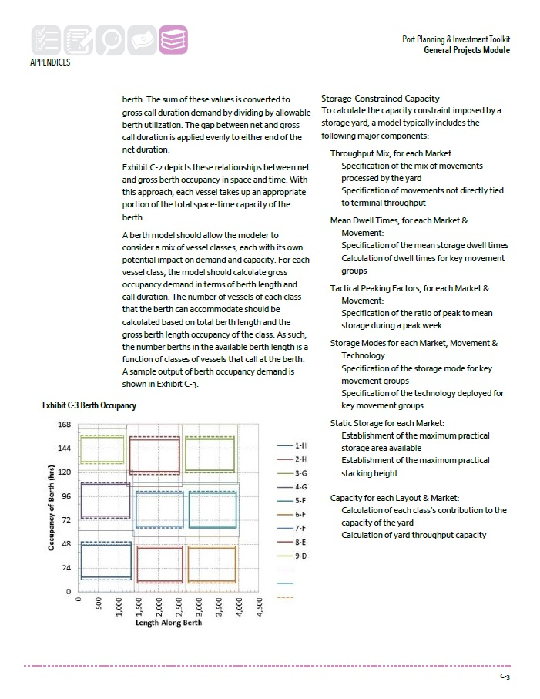
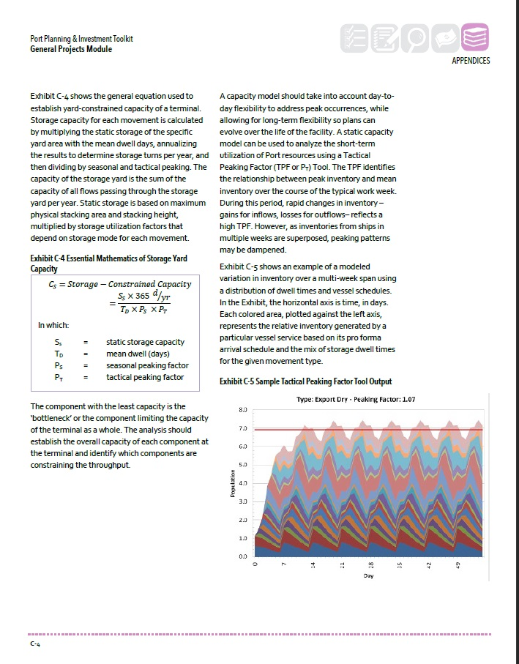
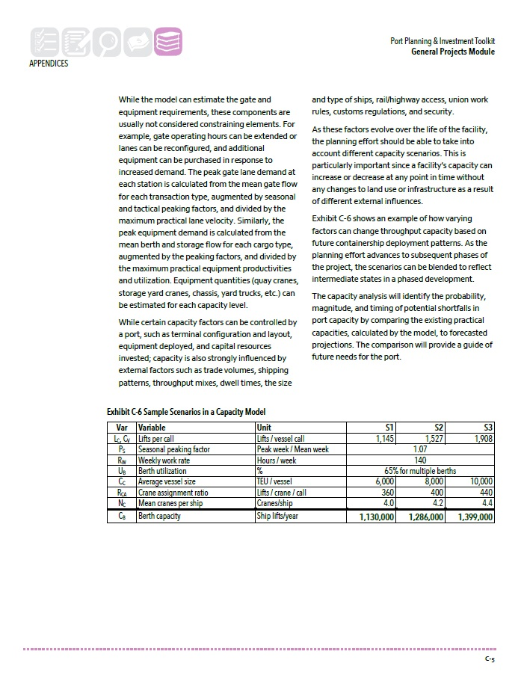
2. Quantify – Existing Conditions, Capacity, cont.
Notes:
I’m definitely not going to get into it, but here’s an excerpt from the appendix relating to performing a capacity analysis.
There’s also another appendix that similarly describes the steps in making a DEMAND FORECAST.

Slide 21
2. Quantify – Project Drivers
PROJECT DRIVERS
Project Drivers are described in the toolkit as “forces external to a port that impact a potential project and that may be the impetus behind a project.”
Examples of Project Drivers provided in the toolkit include:
Regulatory Environment – land use, transportation, environment, labor, health and safety, security, community, funding, etc.;
Market Dynamics;
Competitive Position; and
Demand Forecast.
Identification of the project drivers allows the generation of practical and effective project alternatives that will fulfill the project objectives.
Notes:
After the Existing Conditions are quantified, the toolkit recommends an assessment of Project Drivers.
Project drivers are forces external to a port that impact a potential project and that may be the impetus behind a project.
This step is basically a more project focused assessment of some of the External Influences and the Volumes and Trade Flow information identified during the Existing Conditions stage (again here’s the “back and forth” nature of the planning effort).
Identification of the project drivers allows the port owner to generate practical, effective project alternatives and strategies that will fulfill the project objectives. When considering all the reasons a port undertakes a project plan, consider that projects may have drivers in the following four categories:
• Regulatory Environment – land use, transportation, environment, labor, health and safety, security, community, funding.
• Market Dynamics – assessment of ongoing regional and global trends.
• Competitive Position – features, services, costs, financial strength, etc.
• Demand Forecast – economic growth, historical trends, influencing events, changes in competitive position.

Slide 22
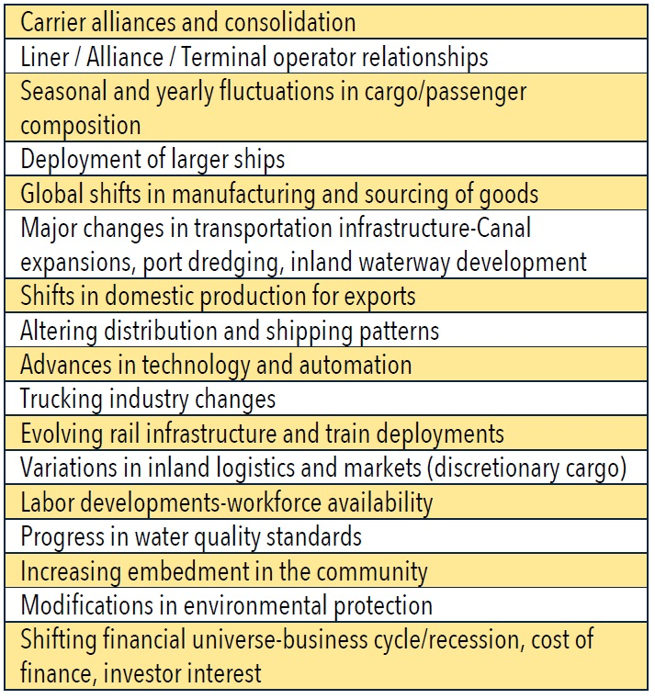
2. Quantify – Project Drivers, Market Dynamics
Notes:
Here’s a chart from the toolkit that outlines some sample factors to be considered as part of the Market Dynamics
Market Dynamics – assessment of ongoing regional and global trends.

Slide 23
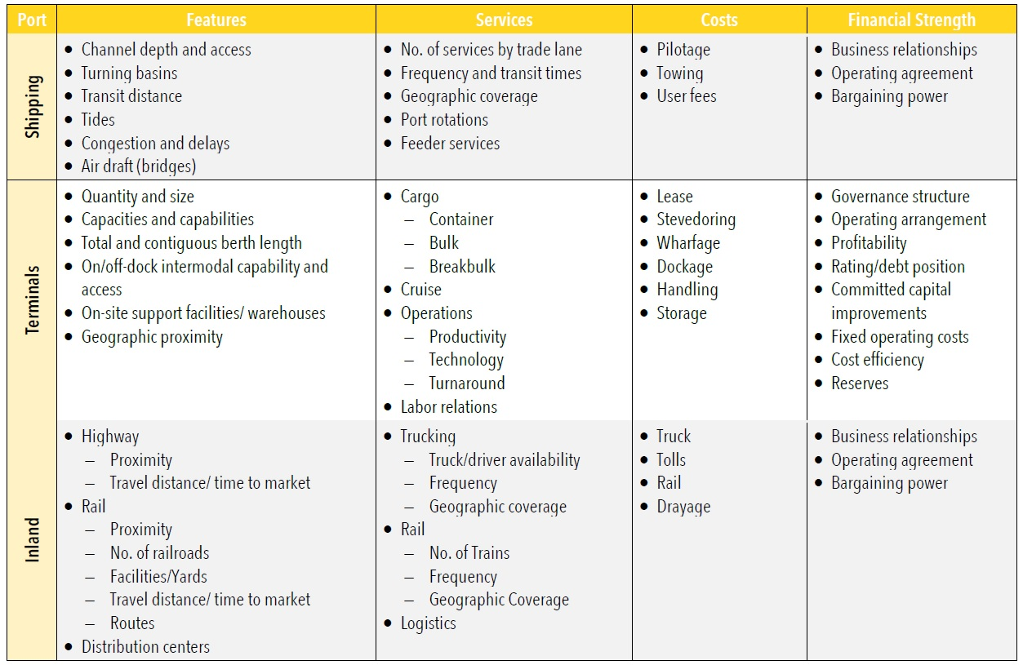
2. Quantify – Project Drivers, Competitive Position
Notes:
And here’s another chart from the toolkit that describes some sample factors that can be used to assess your competitive position.
Features, services, costs, financial strength, etc.

Slide 24
2. Quantify – Project Drivers, Demand Forecast
SAMPLE FACTORS FOR DEMAND FORECAST
What markets/products could reasonably be attracted to the port?
What are the projections for the fundamental drivers of these product volumes?
What are the origins and destinations of the products?
What advantages does the port have in serving these markets?
Where does the port stand in relation to carriers’ service rotations and how might this change in the future (e.g., as a result of evolving alliances or modifications in ship size)?
What are “upstream” and “downstream” ports focused on?
What are the port’s advantages in terms of inland transportation for products, foreign origins or destinations?
What share does the port have of volumes for those markets (products, foreign regions, inland regions) that it could realistically serve?
What are competitive ports’ shares of these markets?
What advantages does the port have, or could potentially have, versus competitive ports in these markets (e.g. inland transportation time or cost)?
Notes:
A analysis of demand and creation of a forecast (or a set of forecasts) serves to establish expected levels of project activity and allows you to estimate a range of anticipated revenues from the project.
The toolkit includes quite a bit of discussion about demand forecasts and, similar to the capacity techniques in Appendix C, offers an appendix that provides insights into performing a demand forecast (Appendix D).
PRO TIP - I will note here that the toolkit recommends the use of scenarios, based on alternative economic outlooks and different assumptions about fundamental driving factors, to develop a range of demand forecasts.

Slide 25
2. Quantify – Project Needs
GAP ANALYSIS
Assesses the differences between a port’s capabilities and performance and its opportunities and objectives relative to a potential project.
PROJECT NEEDS
Based on Gap Analysis. May include changes to infrastructure, equipment, or operations required to address the Project Drivers.
Notes:
The final step described in the toolkit for quantifying a potential project is the definition of Project Needs based on a Gap Analysis.
-READ SLIDE-
GAP ANALYSIS
Quantify capacity gaps by comparing current capacity against the forecasted demand as appropriate.
You should also try to quantify impact gaps. For example, this could include impacts on road congestion, air emissions, or worker safety.
The port’s mission, vision, and goals (actually all of the guiding elements defined in initiation) should be considered when assessing these gaps.
The quantified gaps can then be translated into Project Needs, which may include changes to infrastructure, equipment, operations (or all of the above) that will be needed to address the project drivers AND close the identified gaps.

Slide 26
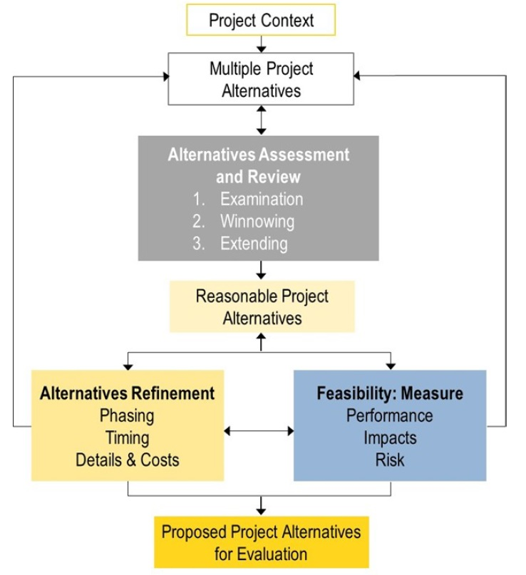
3. Form
Notes:
20:00 MINUTES
Once the existing conditions, projected demands, and project needs have been identified, you can then prepare your project alternatives.
The third phase of the process described in the Planning Module is the Project Form phase. Basically, this is the establishment of the context for your alternatives analysis and the:
Development;
Refinement; and
Assessment of those alternatives.
It’s critical that each alternative include a level of detail that supports comparison among all alternatives. This level of detail will also assist later in the Feasibility stage of the project definition process. Similarly, the outcomes of the analyses described in the Feasibility stage will feed back into this task. So you’ll end up with iterative adjustments and refinements to the alternatives.
The ultimate goal of the Form phase is to identify a small number of highly refined and reasonable alternatives for further analysis and assessment of feasibility and costs.

Slide 27
3. Form – Project Context
Notes:
The first step of the Form phase is to understand (and document) the context in which project alternatives will be considered.
The toolkit discusses Project Context as facilities and infrastructure, but I might suggest that you broaden that definition to include other factors like market dynamics and stakeholder attitudes. Obviously, project context will vary between ports and among all types of projects.
Basically, the goal is to document a range of opportunities and constraints for overall project formation. Then use this information to “calibrate” your consideration of all your alternatives.
But, it’s important to note that new opportunities and constraints come up all the time. You should continue to be on the lookout for changes to the context of a project that might warrant re-assessment of your alternatives.

Slide 28
3. Form – Alternatives Development
Notes:
A major outcome of the Form phase is the development of multiple project alternatives.
Typically, a “No-Build” scenario is the baseline from which you will build your other alternatives.
The development and consideration of alternatives will help you to avoid “tunnel thinking”, and facilitate a rational assessment of the proposed project.
In addition to the project needs identified in the Quantify phase, the creation of your alternatives should include other public benefits and impacts such as safety, sustainability, environmental impact, etc. as well as the community input from your stakeholder engagement. alternatives.
PRO TIP - I think the toolkit says that for those projects involving Federal action, NEPA will require multiple alternatives with public engagement occurring prior to settling on a final alternative. I just want to add that the public engagement and settling of a final alternative (under NEPA) needs to take place WITH Federal involvement. One of the first phases of the NEPA process is the alternatives assessment, and it’s problematic when the preferred alternative has already been identified prior to Federal engagement.

Slide 29
3. Form – Alternatives Assessment
Notes:
Alternatives Assessment is an important component of the Alternatives Development phase of forming a viable project:
The toolkit describes a three-step approach to assessing your project alternatives:
1) Examination - Understanding, at a high level, the physical and institutional elements of each alternative, and how those elements relate to existing conditions and to elements in other alternatives.
2) Winnowing - Eliminating alternatives that do not sufficiently align with project goals and objectives, such as providing inadequate capacity or having the potential to generate unacceptable impacts.
3) Extending - Identifying new alternatives that should be considered or alterations to proposed project alternatives that might provide a better balance of performance capabilities and impacts.

Slide 30
3. Form – Refinement of Alternatives
Notes:
Finally, there is the process of refining your alternatives. As you can see from this toolkit graphic, the refinement of alternatives includes the transition into the Feasibility phase of project development.
The alternatives refinement stage includes a lot of “miscellaneous but important” set of considerations that could have major impacts on your budget or timeline if you don’t consider them in your planning effort.
These “refinement” factors include:
PHASING - Phasing of your project may be necessary to minimize impacts on existing facilities and operations. The last thing you want is for existing business to be lost.
TIMING – The timing of improvements should also be considered. The toolkit mentions this in the context of both market forecasts (busy season) and funding availability.
DETAILS – Details that seem minor can have tremendous impacts. Stakeholder engagement is very, very good at revealing details that could have a major impact. Use your outreach to flesh out an “inventory” of details for consideration with appropriate experts.
PRO TIP - I’m from Florida and stormwater management was consistently an issue soon after new standards were adopted. The requirement in Florida was for stormwater NOT to flow into the water, it had to be directed back from a pier or bulkhead for retention or detention. Similar details include electrical requirements (cold ironing?), security considerations (port and facility security plans), lighting, etc.
COSTS – The toolkit recommends that you develop individual costs and schedules for each timed phase of the overall project as opposed to just a laundry list of specs and tasks with a total at the bottom. Breaking out the costs and schedules provides an opportunity to adjust the plans to better fit your needs and minimize negative impacts. I should also mention that if you plan to use Federal funds toward a project, then that is going to increase your costs. An example of this is the Buy America requirements that will likely result in increased costs for items like steel and equipment. Breaking out your costs and activities also allows for easier segmentation of your project if Federal funds are awarded in less than the requested amount.

Slide 31

Contact Information
Wade Morefield
Office of Ports & Waterways Planning
Maritime Administration
(202) 366-6025
Wade.Morefield@dot.gov
Questions? Ideas?
Notes:
25:00 MINUTES
That’s all I have. I’d just like to encourage you to download the Port Planning and Investment Toolkit from the AAPA website. In addition to the Planning module we discussed today, it has a lot of other useful and interesting content, including some case studies.
I’m happy to answer any questions you may have.

