Slide 1
Lessons Learned from Maritime Energy Storage System Installations
Safe Clean Energy Solutions
Notes:
Reine, Norway

Slide 2
Our Mission
Accelerate the shift to environmentally sustainable energy solutions for maritime industries by providing safe, reliable and economically attractive energy storage systems

Slide 3
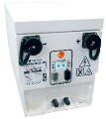
An Industry Leader
Prinsesse Benedikte World’s Largest Hybrid Ferry 2.6MWh ESS
MF Ampere World’s First All-Electric Car Ferry
TESO – Texelstroom World’s Greenest Ro-Pax Ferry
Orca ESS – First Maritime ESS
with Cell-level TR Isolation
First Maritime ESS
Viking Lady OSV First OSV to Validate ESS
Selfa Arctic AS Karoline World’s First All-Electric Fishing Boat
Port Equipment
RTG Cranes
Boeing Echo Voyager World’s First Long Range Underwater Autonomous Vehicle
Notes:
Remove investors

Slide 4
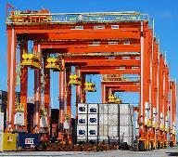
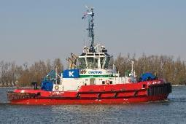
Setting the Maritime Standard
35+ MWh deployed
>1 Million operating hours
Over 50 projects worldwide
Broadest variety of vessel types
Largest portfolio of multi-MWh vessels
Largest installed base of hybrid RTGs
66% global market share

Slide 5
Lessons Learned
System Architecture
Importance of Pack Sizing
Cell Selection
Key Take-aways from Safety Incidents
Designing for Safety

Slide 6
Lessons Learned
System Architecture
Importance of Pack Sizing
Cell Selection
Key Take-aways from Safety Incidents
Designing for Safety

Slide 7
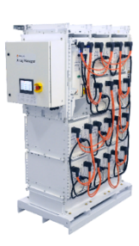
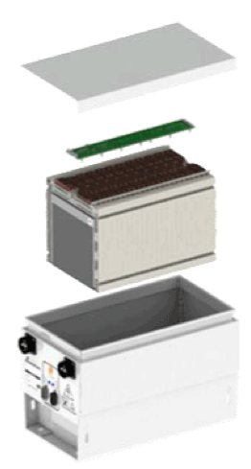
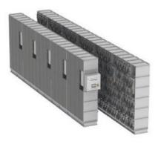
System Architecture
24 Lithium Polymer Cells NMC Chemistry
AT6700 Module
ESS Pack
(10 Modules)
ESS Array
(11 Packs / 110 modules)
Notes:
ESS as ‘virtual generator’ from the EMS/PMS point of view.

Slide 8
Monitoring Critical Activities
Battery Management System
Cell Temperature
Cell Voltage
Charge/ discharge current limits
Current
Safety Disconnect
Notes:
Interaction with integrator
Distributed BMS
Hardware-based safety shutdown
Inputs (left hand side)
Temp
Voltage
Current measurement
Outputs (right hand side)
SoC – change to Safety disconnect
Charge/discharge limits calculated
Safe or not – not then disconnect

Slide 9
Lessons Learned
System Architecture
Importance of Pack Sizing
Cell Selection
Key Take-aways from Safety Incidents
Designing for Safety

Slide 10
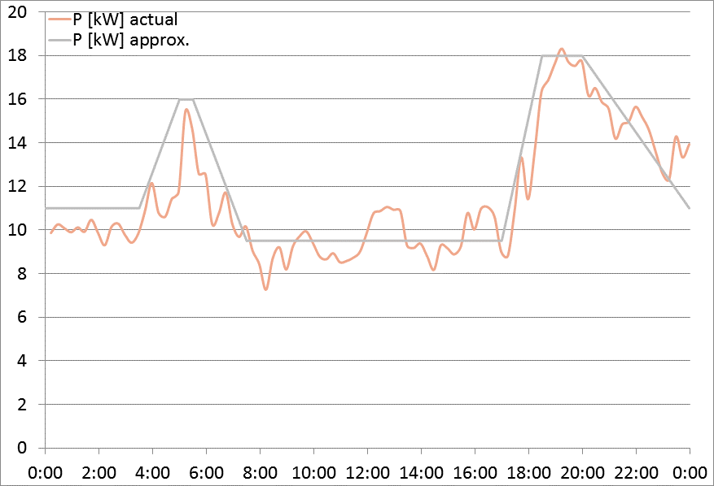
Pack Sizing

Slide 11
Lessons Learned
System Architecture
Importance of Pack Sizing
Cell Selection
Key Take-aways from Safety Incidents
Designing for Safety

Slide 12
Are all lithium batteries the same?
Cell phone battery
ESS battery
Consumer electronics
Safety systems:
Battery management system
Industrial grade
Safety systems:
Advanced battery management systems
Anti-propagation measures
Hazardous gas venting
Notes:
No one in this room needs to really be reminded of this.
Testing vs existing standards: UL1642, IEC 62619, UNT38.3
Note – it has recently come to light that Samsung had issues with batteries from two separate battery manufacturers – they initially blamed 1 single manufacturer and sent replacement phones with a second manufacturer – which it turned out – also had problems.

Slide 13
Lessons Learned
System Architecture
Importance of Pack Sizing
Cell Selection
Key Take-aways from Safety Incidents
Designing for Safety

Slide 14
Key Take-aways from Safety Incidents
Campbell Foss Tug (2012) - Pack Overcharge (repeated)
Updated charge algorithm not adopted by EMS
Pack Controller contactors did not open (last line of protection)
Summary alarms from EMS: did not indicate criticality
Crew silencing of alarms
No absolute maximum voltage setting at control system (not confirmed during commissioning)
Notes:
8 months installed- 3 months overcharge, coinciding with the pack drifting out of balance, along with PMS charging based on SOC (as a function of SOCmin).
Chronic overcharge (period of 3 months) due to:
-Recommended charge algorithm not adopted by integrator (and not followed up on by any parties)
-Pack controller did not open contactors as typical last line of protection.
-Alarm handling: summary alarm from PMS did not indicate criticality of alarms
-Crew silencing of alarms (complacent wrt alarms due to perceived spurious nature of warnings at HMI) -No absolute maximum voltage setting adopted at ctrl system, as instructed but not confirmed at commissioning.

Slide 15
Key Take-aways from Safety Incidents
Lessons Learned
- Integration focus (communication, certification)
- Regression testing (s/w)
Alarm/Fault architecture over-haul
Commissioning focus
Crew training
Battery Room: ventilation, fire suppression
Evidenced by……….(35+ MWh successful installs)
Notes:
Report authored by FOSS but contributed by all three parties.
Report in public domain on-line.
Complex interaction between crew, integrator, and ESS
Nb: even in this event, over 4 yrs ago, the TR event was still limited to a single module. We have had two design iterations since then.
HAZID
-S/w regression testing of all builds prior to release.
- Alarm/fault architecture overhaul
-Integration (communication, training and certification of integrators)
-Commissioning- more comprehensive, 100% checks of all critical faults and alarms.
-Training for crew.
-Battery room analysis wrt ventilation, fire suppression,
doors. (PVC vent duct was used which ultimately melted during the fire and allowed contamination of adjacent engine room)
-ESS risk assessment to inform specific vessel risk assessment.

Slide 16
Lessons Learned
System Architecture
Importance of Pack Sizing
Cell Selection
Key Take-aways from Safety Incidents
Designing for Safety
Notes:
How we have overcome the

Slide 17
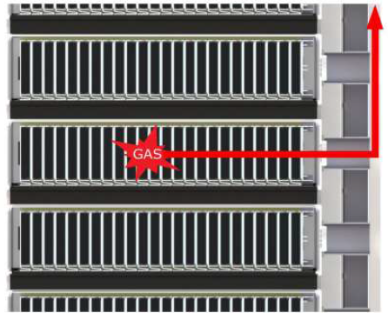
Designing For Safety
Integrated TR Vent Duct in rack
No need for fire suppression
Notes:
Orca – control of TR gases through internal vent pathway

Slide 18
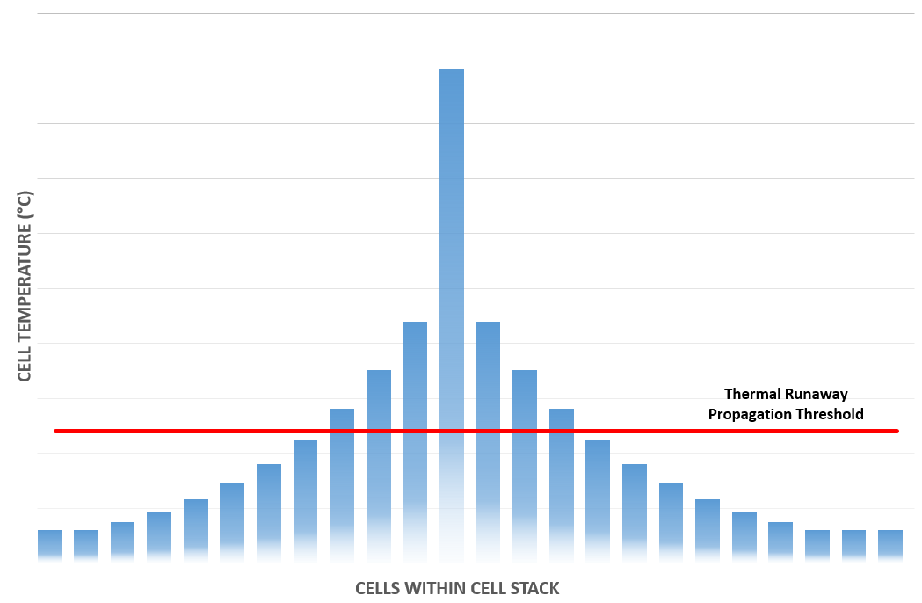
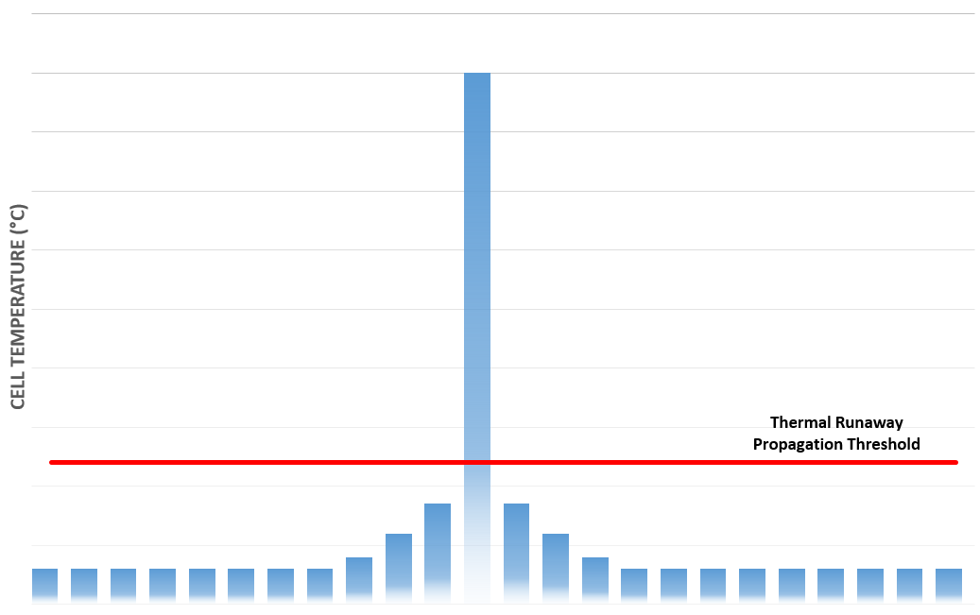
Designing For Safety: Cell Level TR Isolation
Module-level isolation
Thermal runaway propagates to adjacent cells
Cell-level thermal runaway isolation
Adjacent cells stay cool
No active protection elements required
Temp
Temp
Individual Cells
Individual Cells
Notes:
Orca – control of TR gases through internal vent pathway
Passive protection: module has same level of propagation protection whether installed, in transit, or during installation

Slide 19
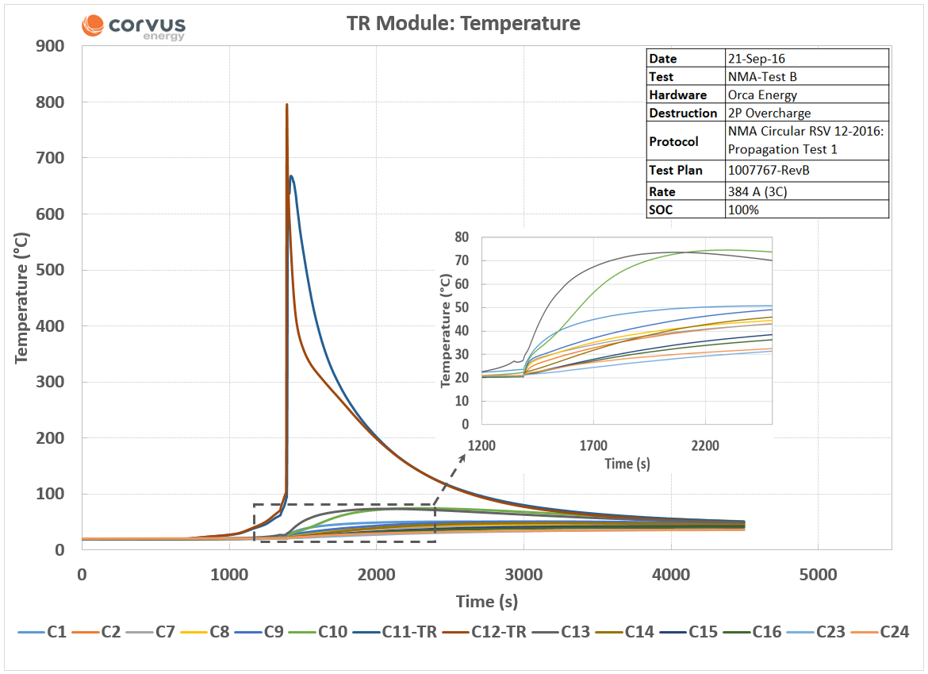
Designing For Safety: Cell Level TR Isolation
NMA Non-Propagation Test #1
Cell (pair) overcharge at maximum of cell design
BMS deactivated
All cells at 100% SOC
No cooling, fire extinguishing, ventilation
Repeated 3 times with witnesses
Result:
No vented cells other than original two overcharged cells
Notes:
NMA Test B – 21 Sept 2016
Cell 11 and 12 TR
Max cell temp = 74 C (not even high enough to trip the H/w based alarm). This was ~ 2cm away from a cell undergoing TR.

Slide 20
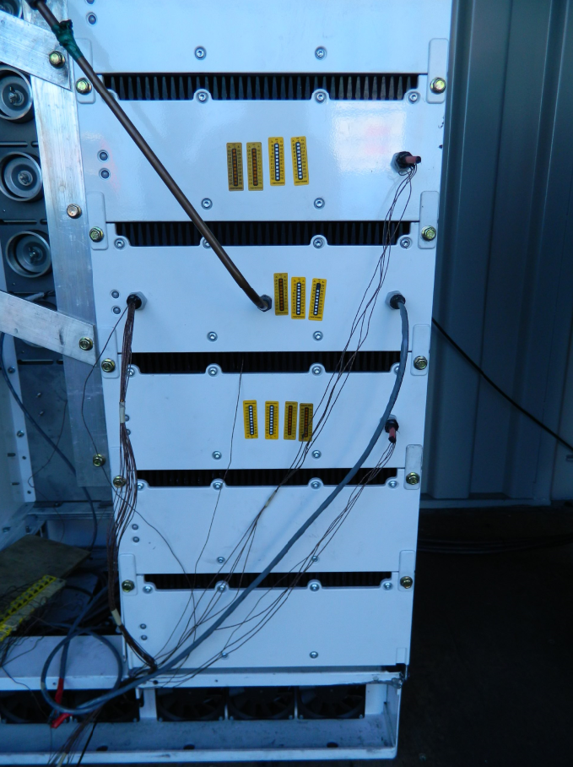
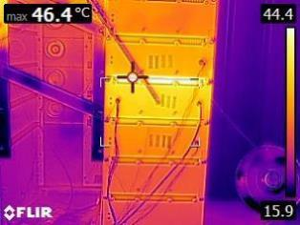
Thermal Runaway - Before and After
NMA Non-Propagation Test #1
No fire suppression
No cooling
Notes:
NMA Test C: TR Module 70 minutes after event
Thermal sticker on front panel indicated up to 46 deg C
NMA Test: no cooling, no fire suppression, overcharge at 3C

Slide 21
Lessons Learned
System Architecture
Importance of Pack Sizing
Cell Selection
Key Take-aways from Safety Incidents
Designing for Safety

Slide 22
THANK YOU

